Slide 1

Home automation using Google Assistant and Nodemcu

Slide 2
Team: Abishai G BL.EN.U4ECE22263 Prajwal J Gautham BL.EN.U4ECE22263

Slide 3
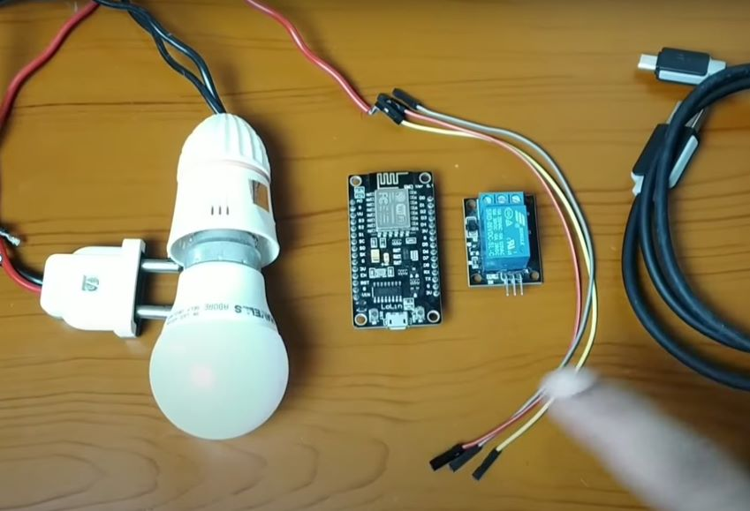
HARDWARE REQUIREMENTS
NodeMCU
Relay
LED bulb
Breadboard
Jumper cables

Slide 4



SOFTWARE REQUIREMENTS
Arduino IDE
Blynk app
IFTTT

Slide 5
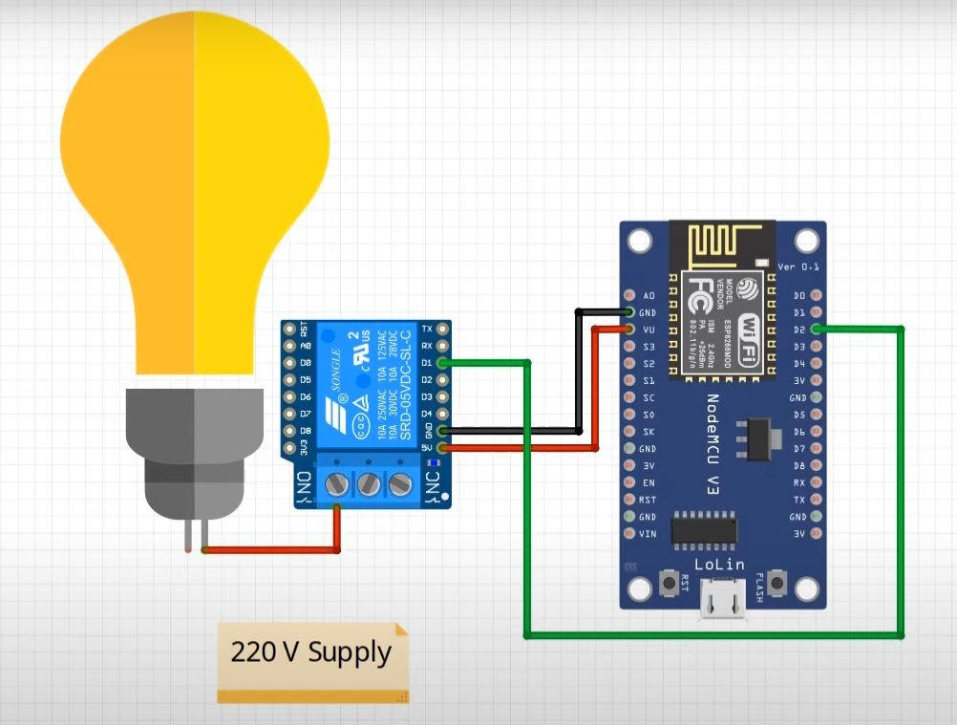
CIRCUIT DIAGRAM

Slide 6
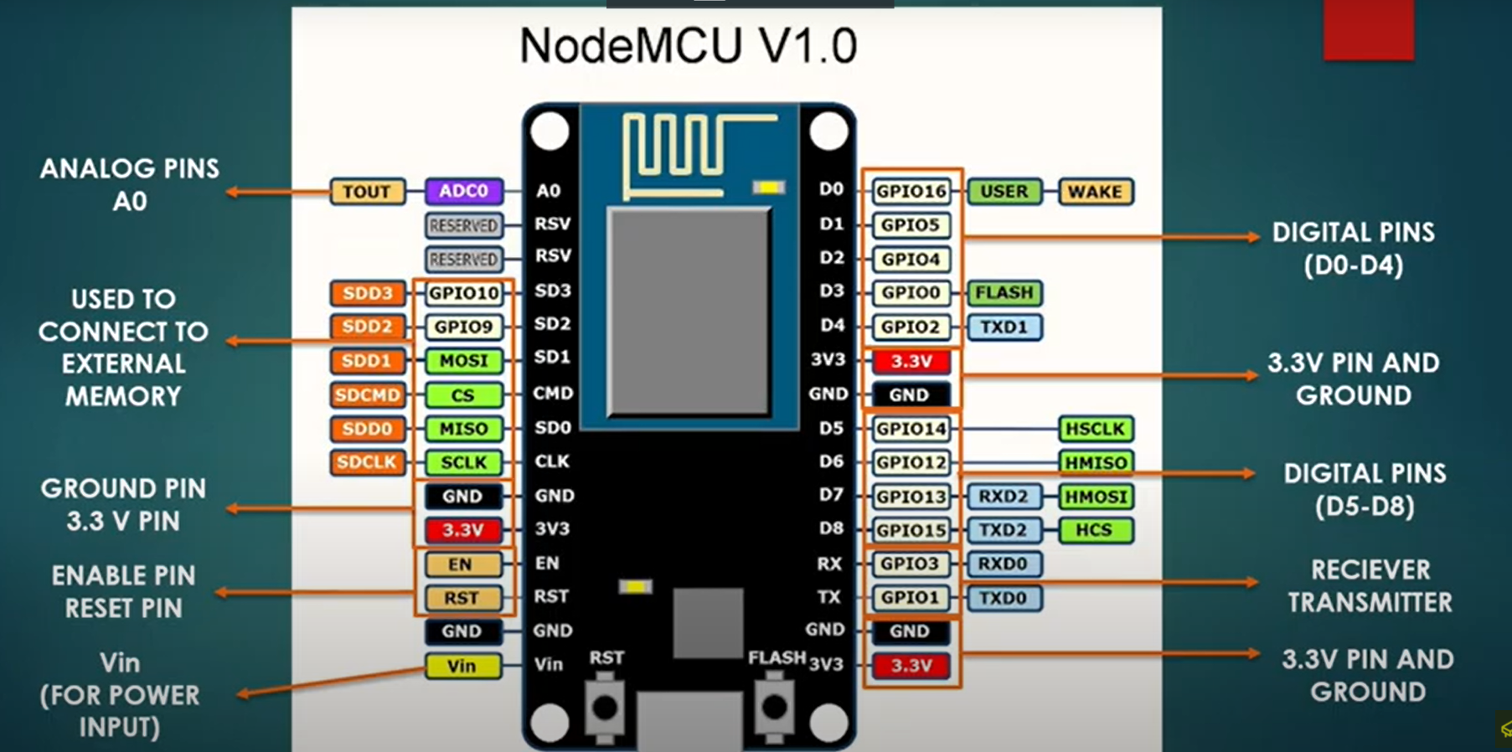
Node MCU V 1.0

Slide 7
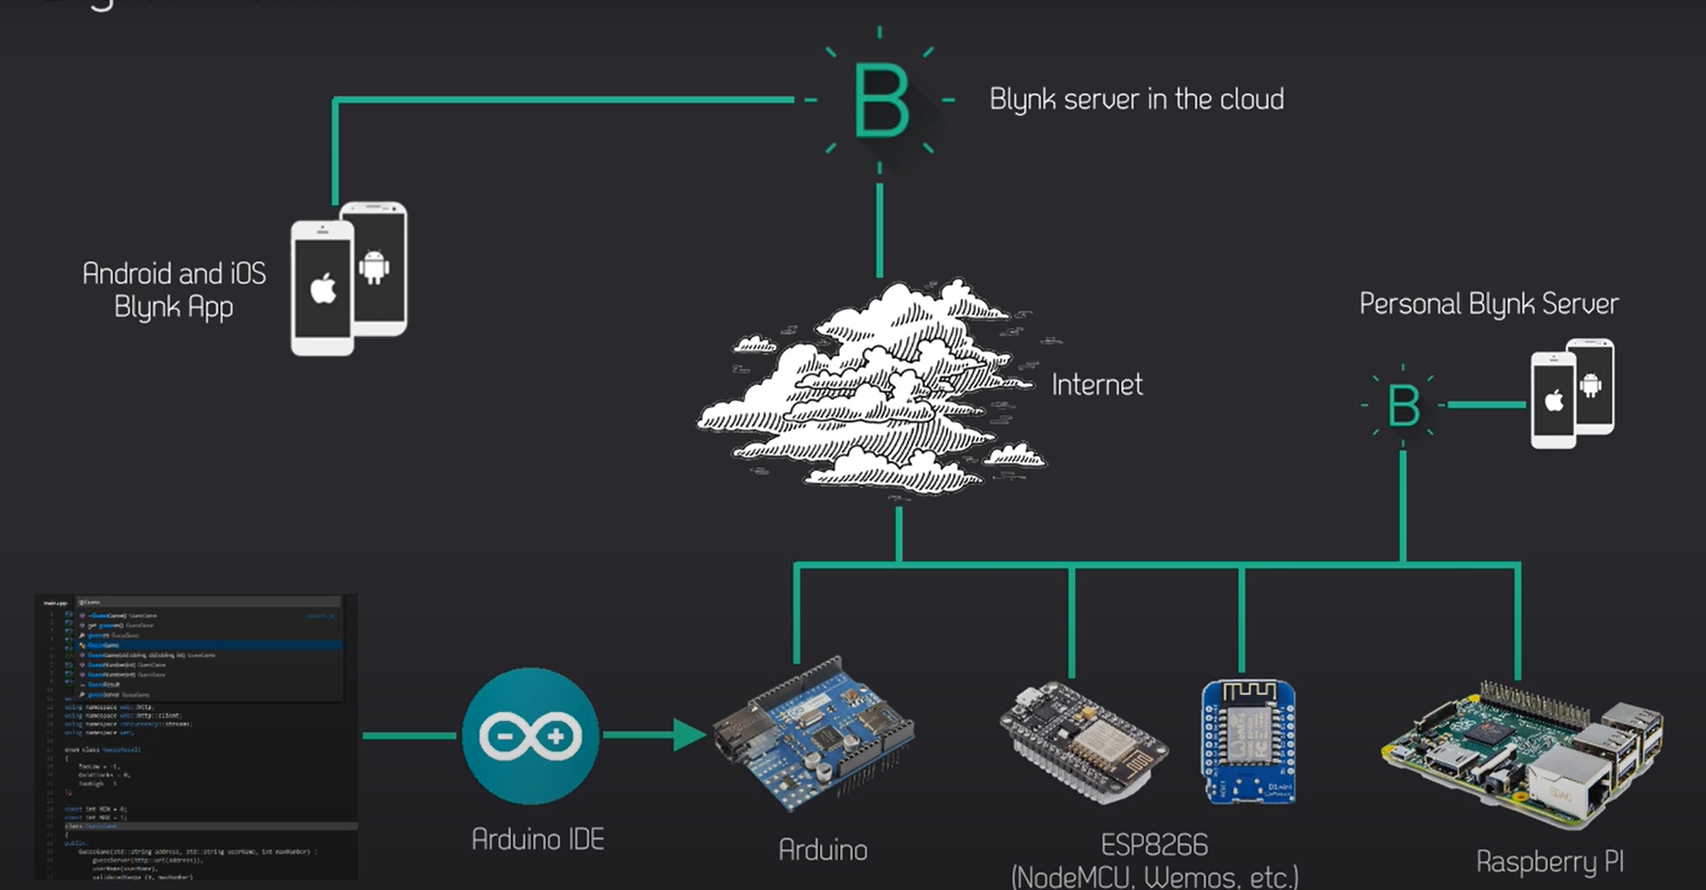
How Blynk works

Slide 8
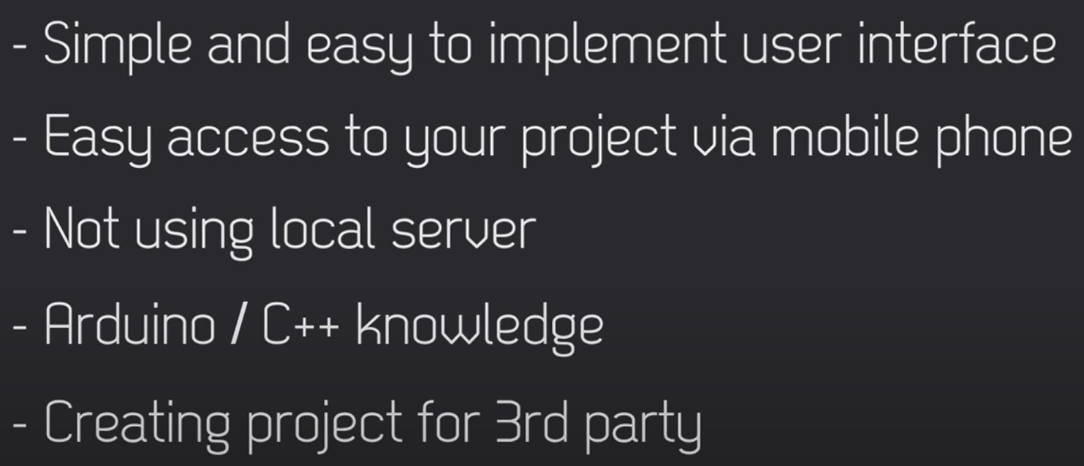
When to use Blynk

Slide 9
What is an IFTTT
IFTTT derives its name from the programming conditional statement “if this, then that.”
What the company provides is a software platform that connects apps, devices and services from different developers in order to trigger one or more automations involving those apps, devices and services.

Slide 10
Source Code:
#define BLYNK_TEMPLATE_ID "TMPL3qLYTwGhN"
#define BLYNK_TEMPLATE_NAME "LED"
#define BLYNK_AUTH_TOKEN "rCxsc5uQuxaj3OnW3nlg-huePlpePwJR"
#define BLYNK_WIFI_SSID "nodemcu"
#define BLYNK_WIFI_PASS "nodemcu"
#define BLYNK_FIRMWARE_VERSION "0.1.0"
#define BLYNK_PRINT Serial
//#define BLYNK_DEBUG
#define APP_DEBUG
// Uncomment your board, or configure a custom board in Settings.h
//#define USE_SPARKFUN_BLYNK_BOARD
//#define USE_NODE_MCU_BOARD
//#define USE_WITTY_CLOUD_BOARD
//#define USE_WEMOS_D1_MINI
#include "BlynkEdgent.h"
BLYNK_WRITE(V0)
{
if(param.asInt()==1){
digitalWrite(2, HIGH);
}
else{
digitalWrite(2, LOW);
}
}
BLYNK_CONNECTED()
{
Blynk.syncVirtual(V0);
}
void setup()
{
pinMode(2, OUTPUT); // Initialise digital pin 2 as an output pin
Serial.begin(115200);
delay(100);
BlynkEdgent.begin();
}
void loop() {
BlynkEdgent.run();
}

Slide 11
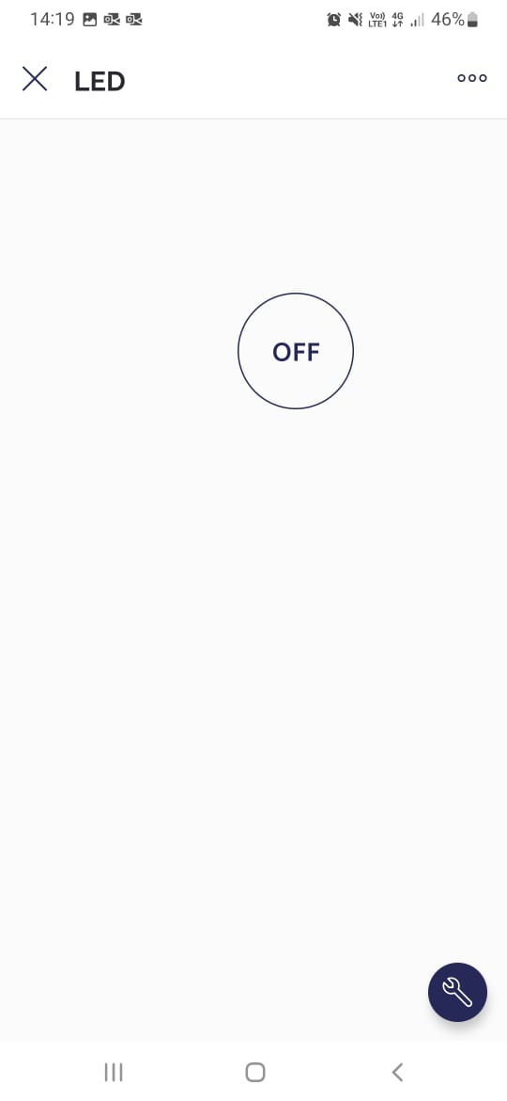
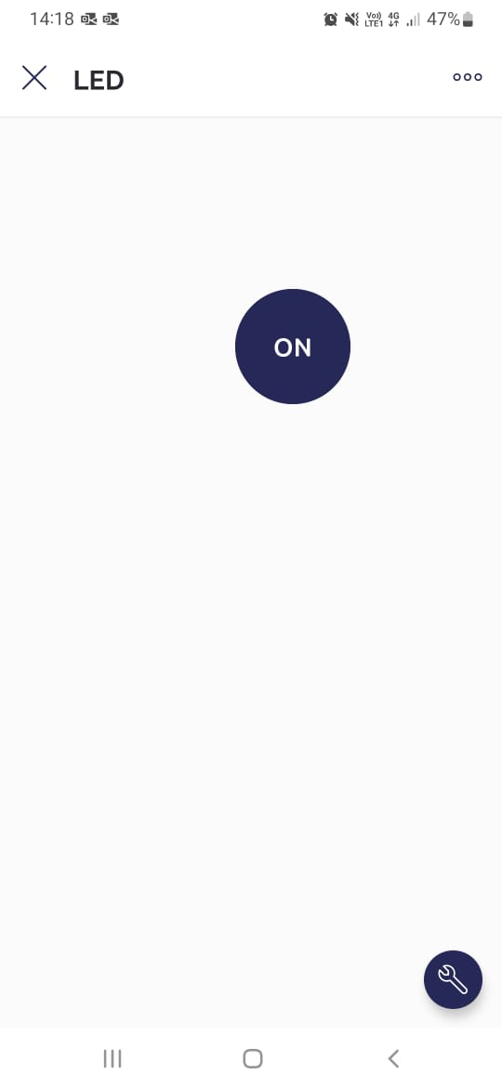
BLYNK APP GUI

Slide 12
DEMONSTRATION

Slide 13
Advantages
We can access it from anywhere we just need the appliance or component to be connected to wifi.
Many people who are disabled can use their voice to turn of components

Slide 14
Disadvantages
Sometimes we ignore to use them.
Home automation for an entire house would result in high cost

Slide 15
Future Scope
Increased efficiency, control, and customization
Voice control and natural language processors like amazon and alexa when integrated and more can be integrated anywhere to control devices at home
It can be used for safety and security as well like home alarm systems.

Slide 16
Thank You

